Slide 1
Importance of Java Application in Software Engineering

Slide 2





Introduction of the group members
Mosfeq Ahamed nayim
ID:19203103057
Rahat Alfaz Abir
ID:19203103105
Musfiq Ahamed marfy
ID:19203103059
Md. Polash Islam
ID:19203103075
Md. Emtiyaj Uddin Emon
ID:19203103089

Slide 3
Contents of this presentation
Introduction to computer science
What is Java?
How does java works?
Why Developers prefer Java
Priority of Java in IT sector
Java applications in our daily life
Disadvantages of java
Conclusion

Slide 4
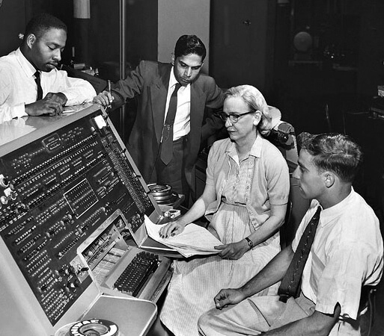
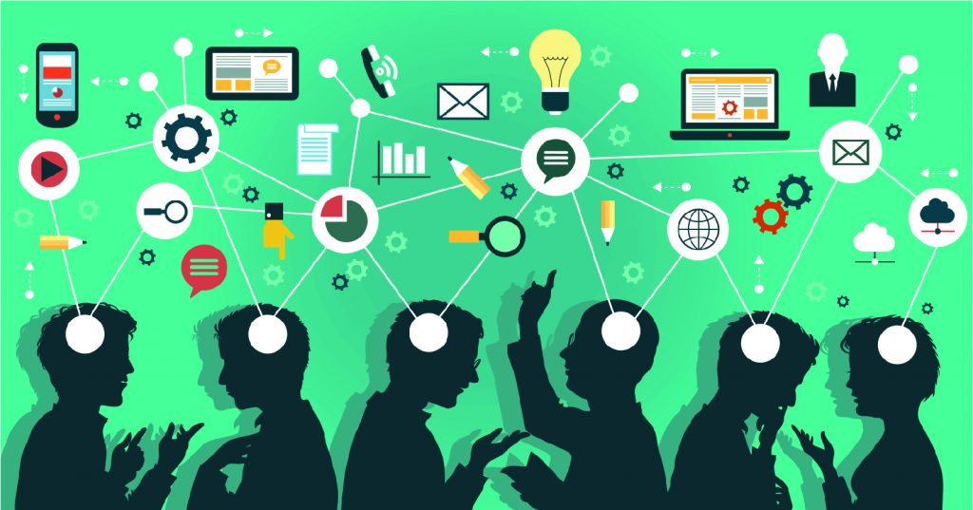
Introduction to computer science
Ada Lovelace
The growth of the software industry

Slide 5






Giant companies in software world

Slide 6
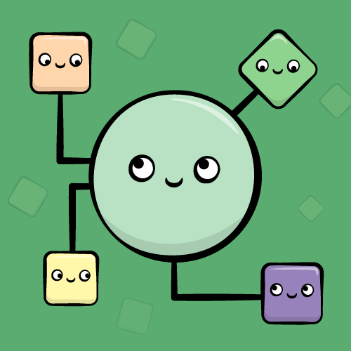
What is Java
?
Java is a programming language that is mainly based on object oriented programming and designed for having lesser implementational dependency.
It was first developed by SUN microsystem (james gostling)
It was initially called OAK but was renamed JAVA in 1995
It was build in modern days that’s why java become
the language of internet

Slide 7
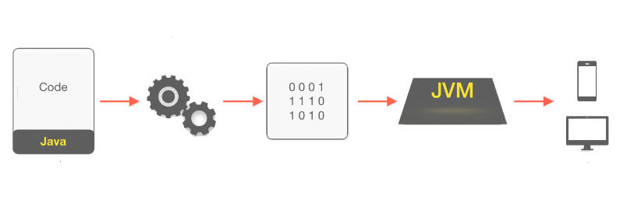
How does java work
Java works in two stage:
Java virtual
machine
Java compiler
Hello.java
Hello.class
Devices

Slide 8
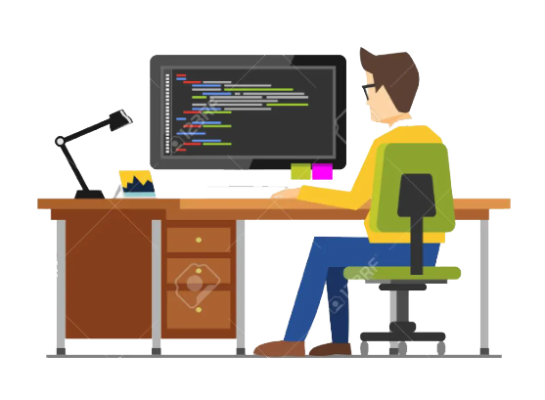



Why developers like java
Developer working
Time
Comfortable Environment
Developers like to work fast and in a comfortable Environment
Java provides comfortable Environment and the Language is user friendly this makes it easy to work with.

Slide 9
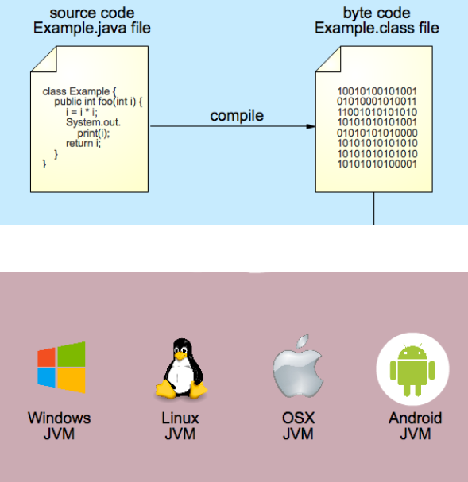

Slide 10
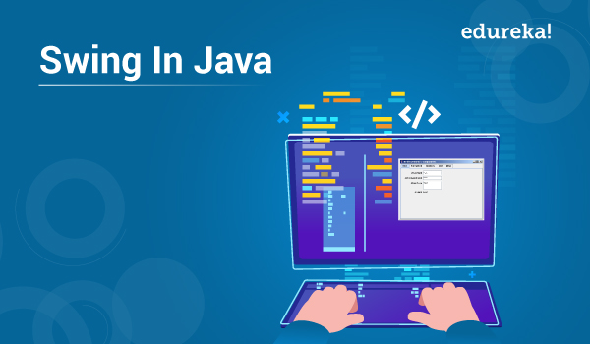
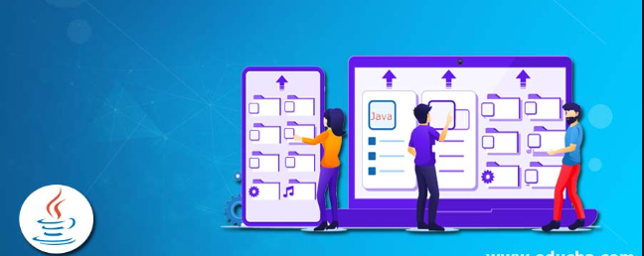
Priority of Java in IT sector
Java is quite known for its inbuild application building classes
Java Swing
Java Graphical User Interface

Slide 11
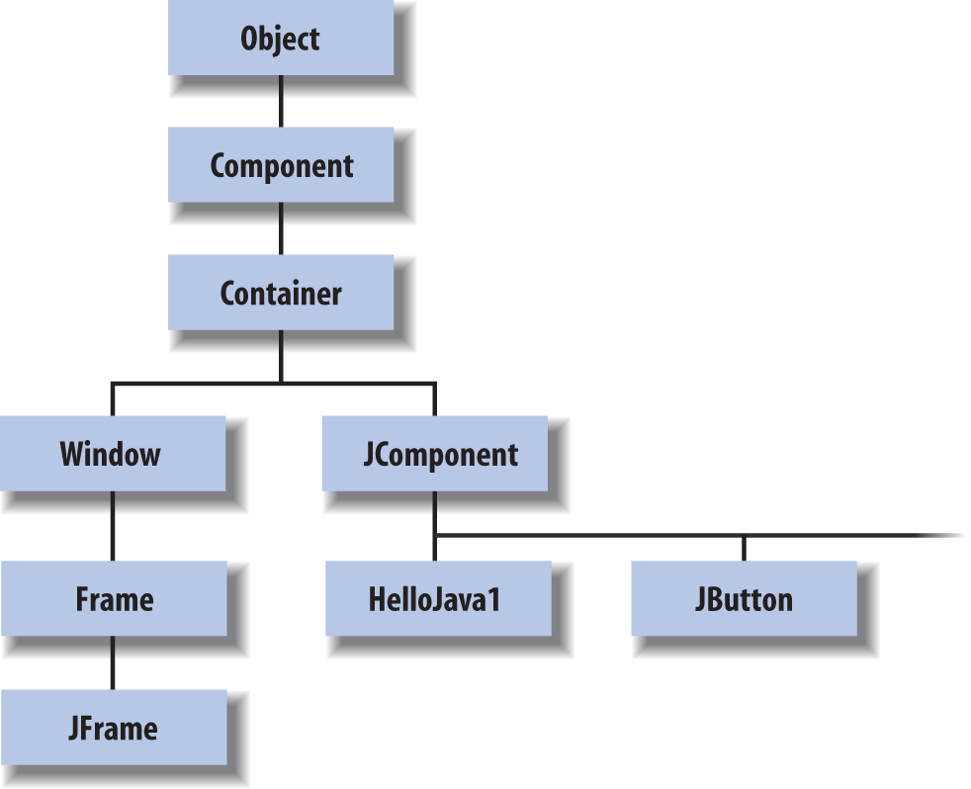

Slide 12
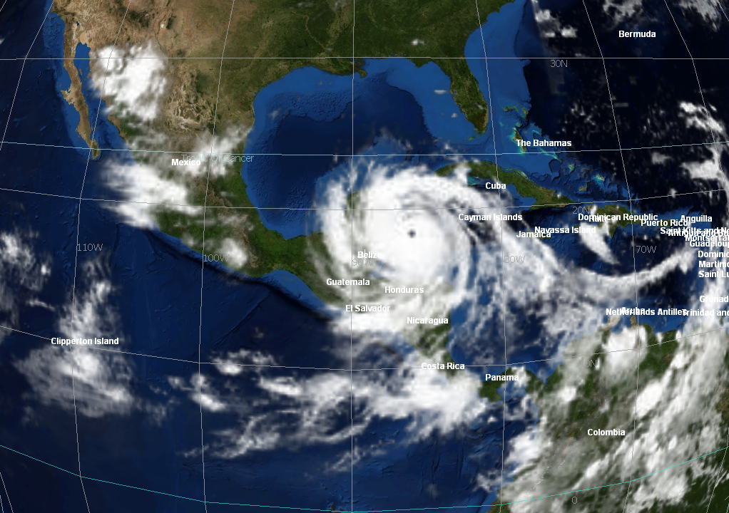
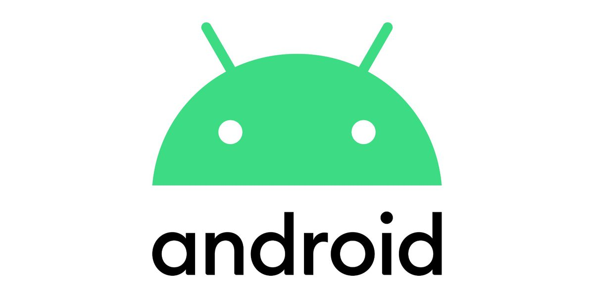
Java applications in our daily life
NASA World Wind belongs to the type of geographic information systems. The app uses a 3D interactive system to make images of our earth. It is also used to make 3D models of the moon, mars ,Venus and Jupiter.
NASA World Wind
Google also Uses java in different sectors of its work. One of the biggest OS, the android OS was inspired from the concept of the java virtual machine.

Slide 13
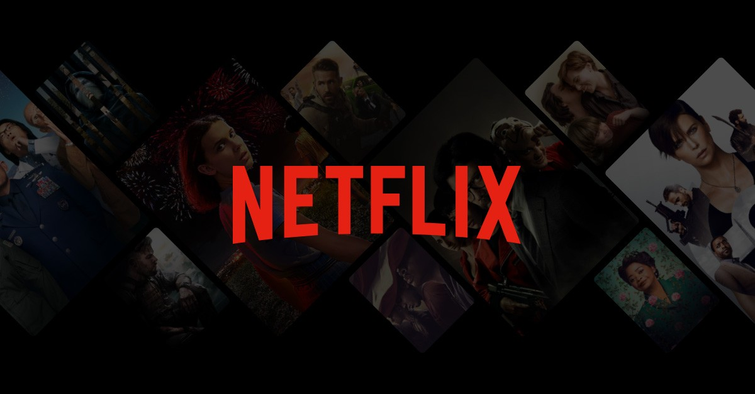
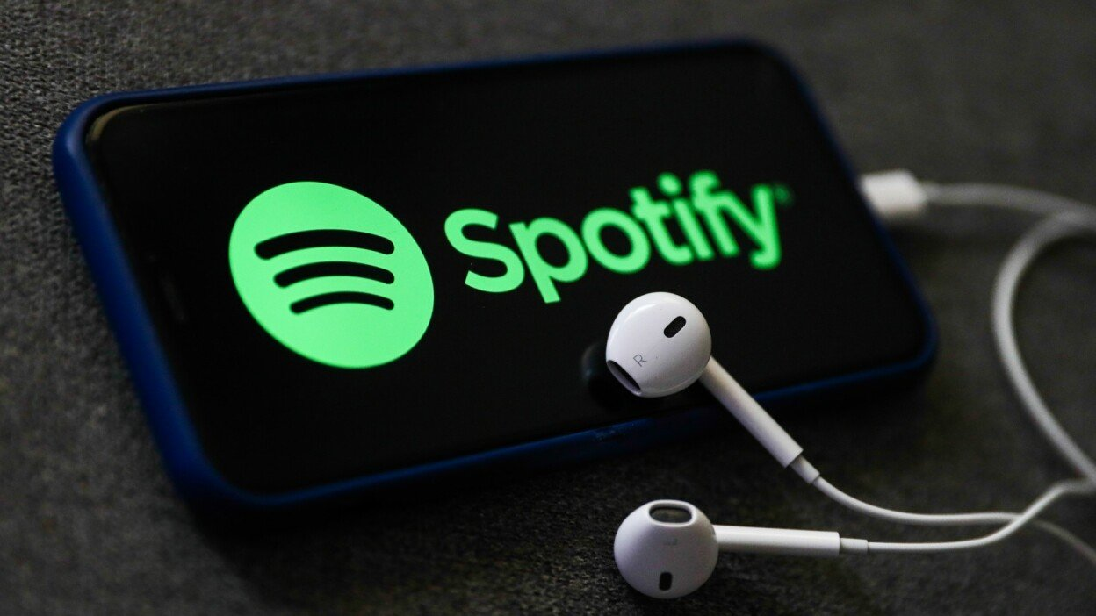
Most of the back end work of Netflix is done in java along with some code in python and C++.
The games and other application based fractures are also made with java
The android application of spotify is purely made on java. The web based application uses java to stabilize the data transfer and of course the back end is also done in Java

Slide 14
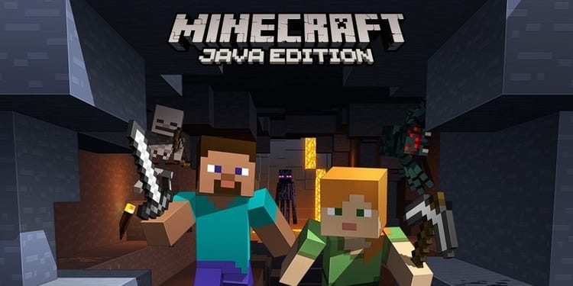

The famous 5 time game of the year winning game minecraft is also made with java.
Today Linkedin is one of the best social networks for searching and establishing business contacts.
The server side of linkedin is handled by java.

Slide 15




Slide 16
Disadvantages of Java

